Slide 1
Classroom Management System
26/10/2020

Slide 2
Meet our team
Tasnim
Muntaha
Farhan
Khadija
180041108
180041118
180041120
180041153
Notes:
https://www.freepik.com/download-file/4077610

Slide 3


The Problem?
Scarce Facilities
Too many Students and Rooms to be Manually Managed
Poor Management resulting in Booking Conflicts and Manual Errors
Unavailability of classrooms for Unscheduled Extra Classes and Quizzes

Slide 4
Classroom Management System
CMS
Real-time MANAGEMENT INFORMATION SYSTEM (MIS) for classrooms that can be accessed, updated and administrated by multiple categories of users from anywhere.
4

Slide 5
Features
01
Real-time Access
classrooms at a particular time along with schedule-booking
02
Search and Book
classrooms based on our requirements according to the classroom features
03
Access and Modify
records booked by a user
04
Access Control
for different category of users

Slide 6
It’s easy with cloud computing”
6

Slide 7

Scope of the Project
Real-Time Cloud Based Database – Firebase with Firebase API
01
02
Multi-Platform Compatibility
- WebApp & Android App using Android Studio
03
Graphical User Interface (GUI)
- HTML, CSS, JS with Bootstrap Framework using Android Bootstrap Library

Slide 8
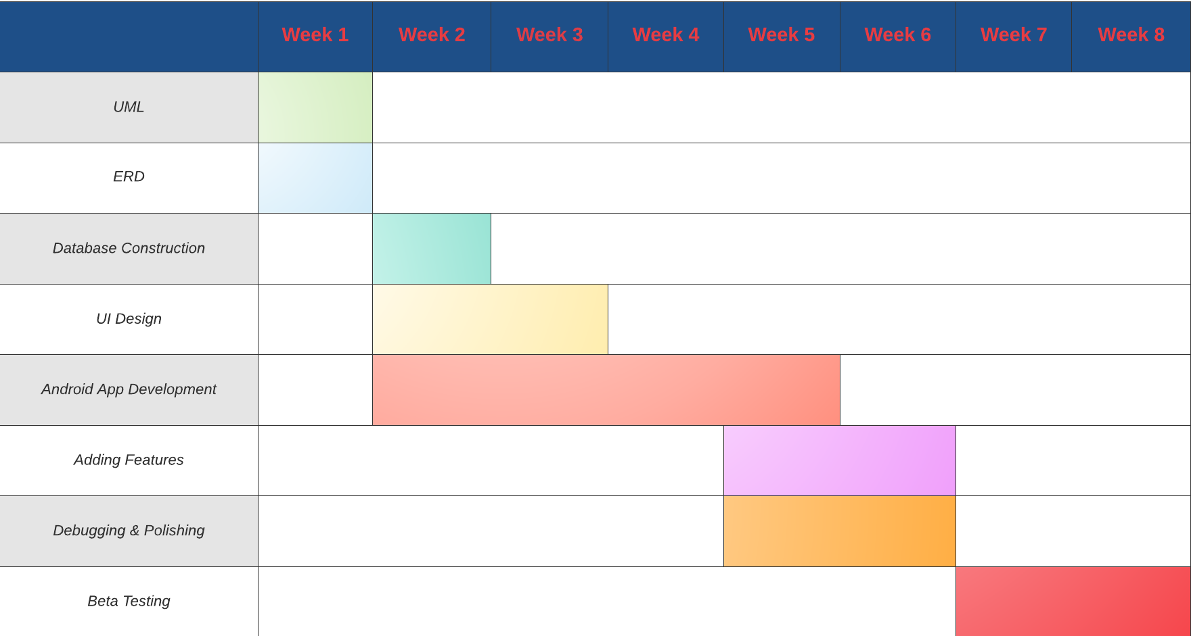
Gantt Chart

Slide 9

Thank You

